Slide 1

Government Regulations / Activity Impacting the Automotive Supply Chain

Slide 2
How OpenChain standards can help manage the United States Executive Order, NTIA Minimum Requirements, CRA and more

Slide 3
Addressing US Executive Order / NIST / CISA
OpenChain ISO/IEC 5230 and ISO/IEC 18974 require the use of SBOMs.
They are flexible enough to meet any specific requirements the US develops around SBOM use, structure or format.

Slide 4
Addressing the CRA
OpenChain ISO/IEC 5230 and ISO/IEC 18974 asked for record-keeping before Cyber Resiliency Act (CRA) made it into a requirement.
OpenChain ISO/IEC 5230 and ISO/IEC 18974 require companies to create and archive verification materials around open source license compliance and security assurance.

Slide 5

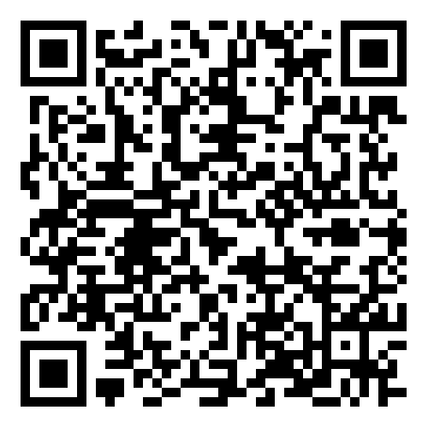
Policy and Regulation Webinar Series:

Slide 6
The OpenChain SBOM Study Group – Rationale and Relevance

Slide 7
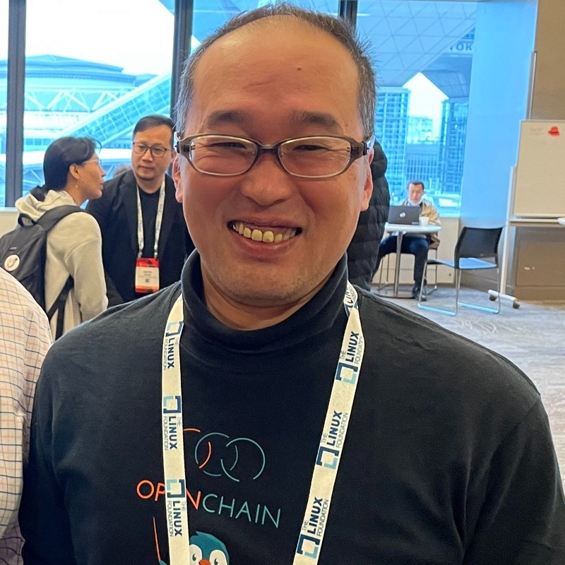
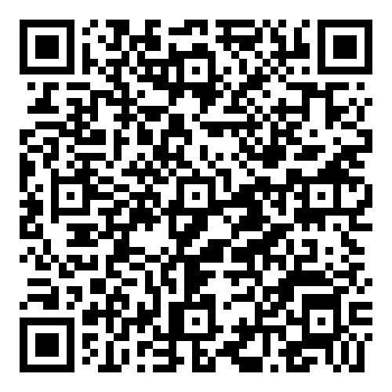
New SBOM Study Group
The OpenChain Project has required Software Bill of Materials for its standards since 2016. Over the years, we have contributed to the field by developing SPDX Lite (a simple SBOM for suppliers) and releasing a guide to define SBOM Quality. This study group is exploring the question of “how do we use SBOMs in production?”
July

Slide 8
Progress Report
There was a kick-off call in late July. The main outcomes was confirming SPDX Lite would be included in updates to SPDX ISO 5962. This was a concern due to changes in the SPDX Project around SPDX 3.0.
The second meeting is scheduled for late September. It will discuss the expansion of the Telco SBOM Quality Guide into a cross-industry / cross-standard guide.

Slide 9
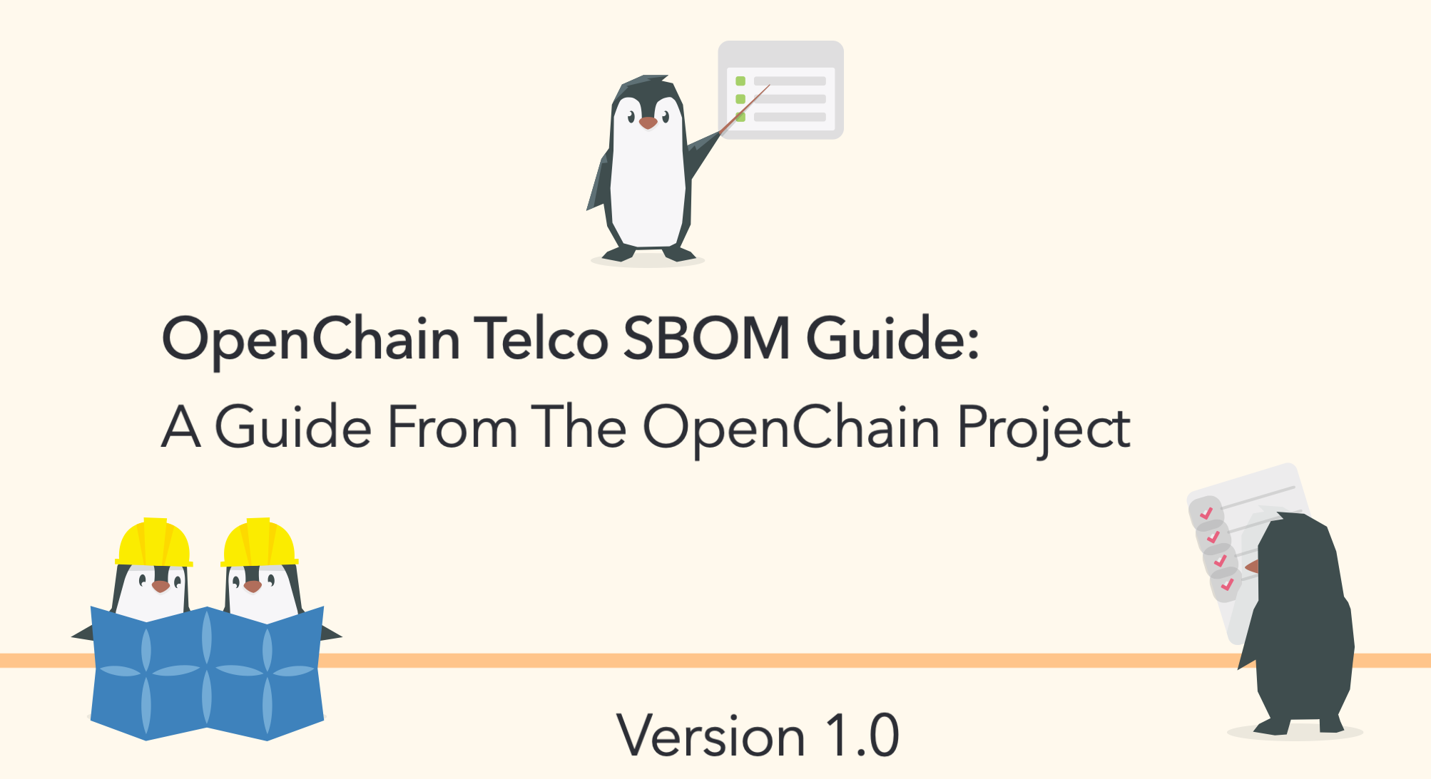
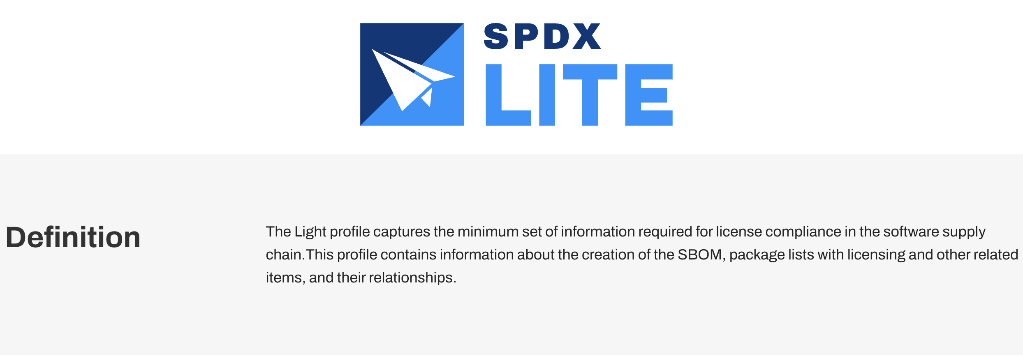
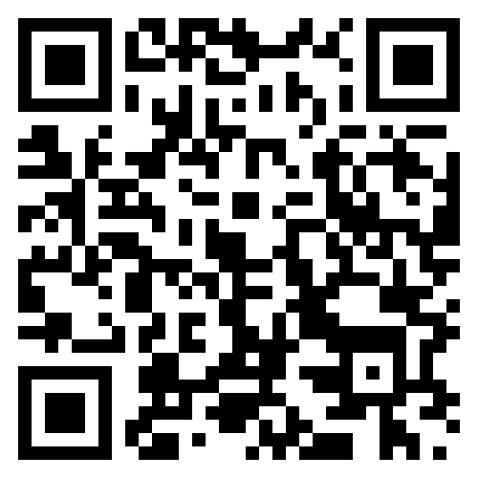
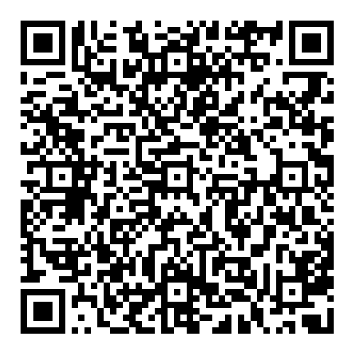
Practical Outcomes Supported and Reviewed

Slide 10
The OpenChain AI Study Group – Rationale and Relevance

Slide 11


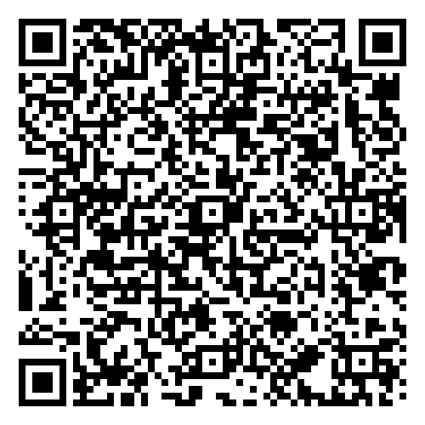
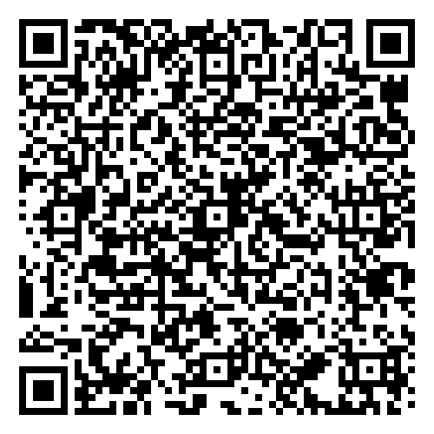
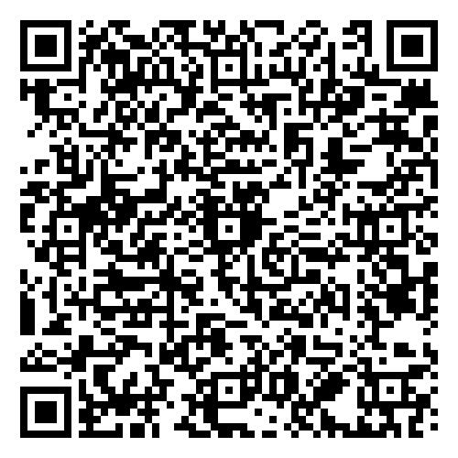
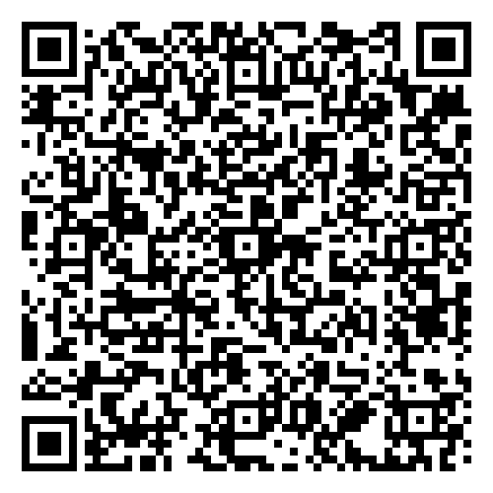
Overview of the AI Study Group
Workshops are held once a month discussing AI Compliance in the supply chain co-chaired by Matthew Crawford from Arm and David Marr from Qualcomm. The meetings focus on identifying shared concerns across industries.
April
May
June
July

Slide 12
Progress Report
There has been specific work in mapping commonalities between our current ISO standards and AI compliance matters.
Prior to the August break, there was discussion about a guide about to AI BOM in the trusted supply chain.
Regular meetings return in October. Meanwhile, there will be an OpenChain Webinar on AI: The Current Legal Landscape - 24th September

Slide 13
In Conclusion

Slide 14
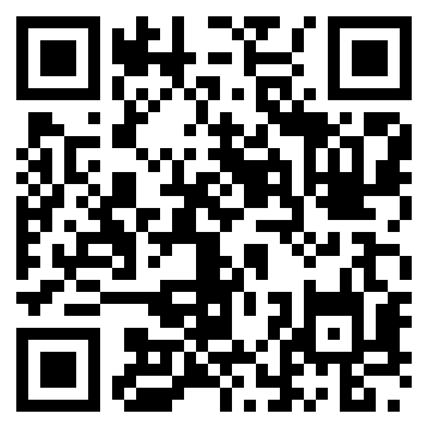
Community Study and Work Groups
Core Work Groups
Education (Autumn 2020~)
Specification (Spring 2016~)
Community Work Groups
Automation (Summer 2019~)
Community Study Groups
AI (January 2024~)
Industry-Specific Work Groups
Automotive (Summer 2019~)
Telecom (Spring 2021~)
Regional User Groups
China (Sept 2019~)
Germany (Jan 2020~)
India (Sept 2019~)
Japan (Dec 2017~)
Korea (Jan 2019~)
Taiwan (Sept 2019~)
UK (June 2020~)

Slide 15
Track All This Work
Our calls are open and publicly listed.
We publish a recording of every meeting not under Chatham House Rule.
We provide access to work groups, special interest groups and local work groups via mailing list.
We also use Slack and WeChat.
All the details can be found on our participation page.

